Slide 1

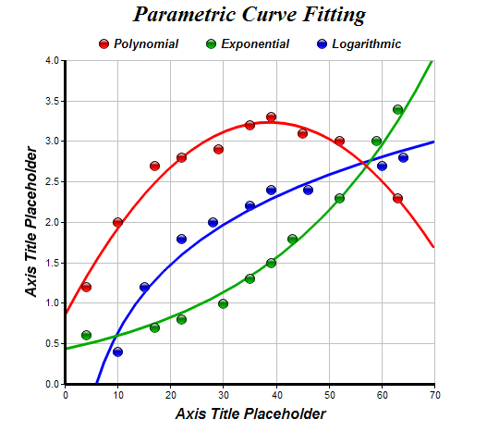
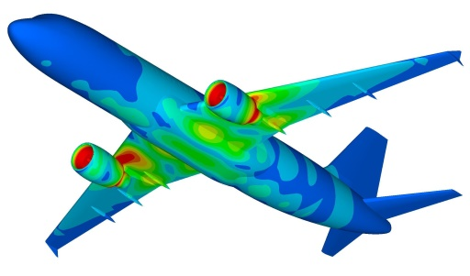
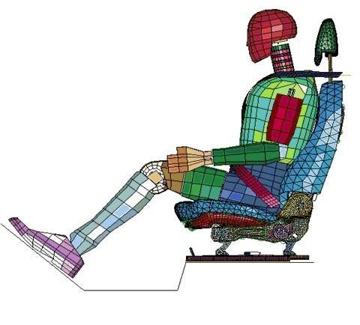
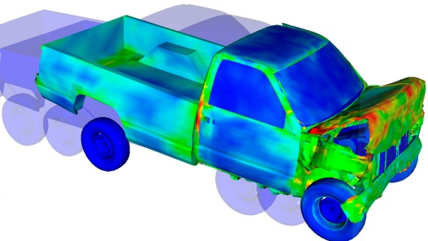
Curve Fitting
Dr. Himanshu Pathak
himanshu@iitmandi.ac.in

Slide 2
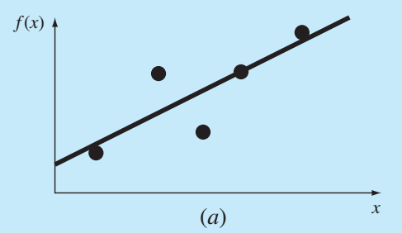
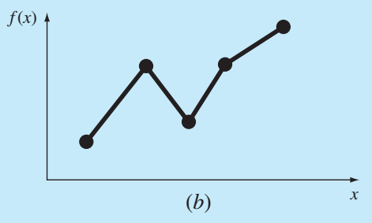
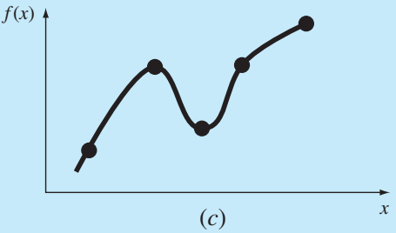
Curve Fitting
It is the process of constructing a curve, or mathematical function, that has the best fit to a series of data points, possibly subject to constraints.
It is a statistical technique use to drive coefficient values for equations that express the value of one(dependent) variable as a function of another (independent variable)
Regression: Data exhibit a significant degree of scatter. The strategy is to derive a single curve that represents the general trend of the data.
Interpolation: Data is very precise. The strategy is to pass a curve or a series of curves through each of the points.
Least square Regression
Linear interpolation
Curvilinear interpolation

Slide 3
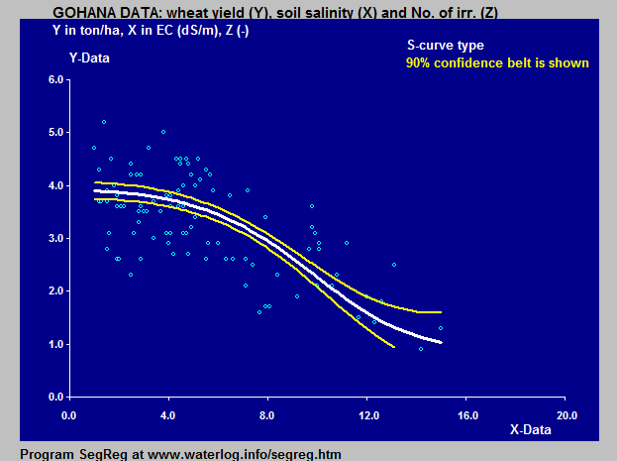
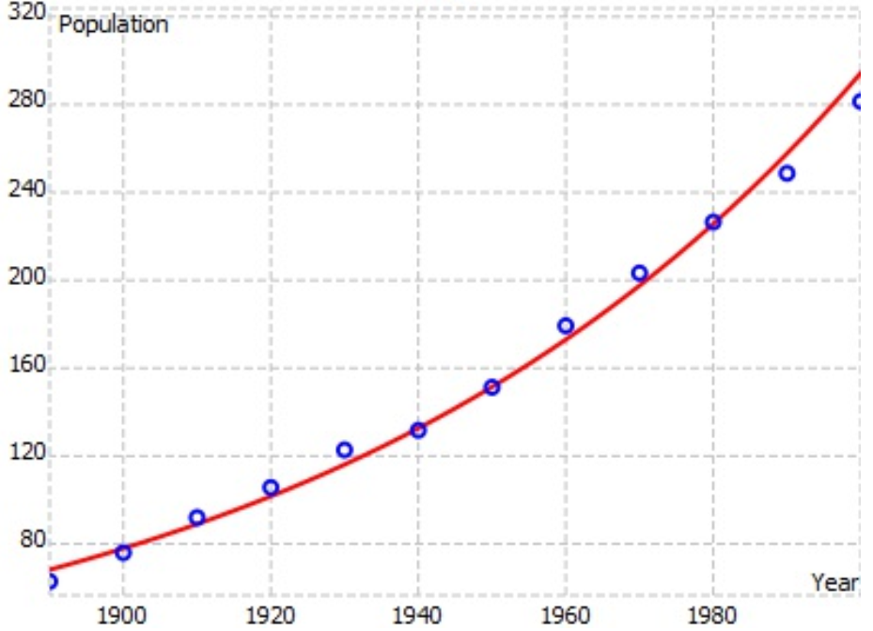
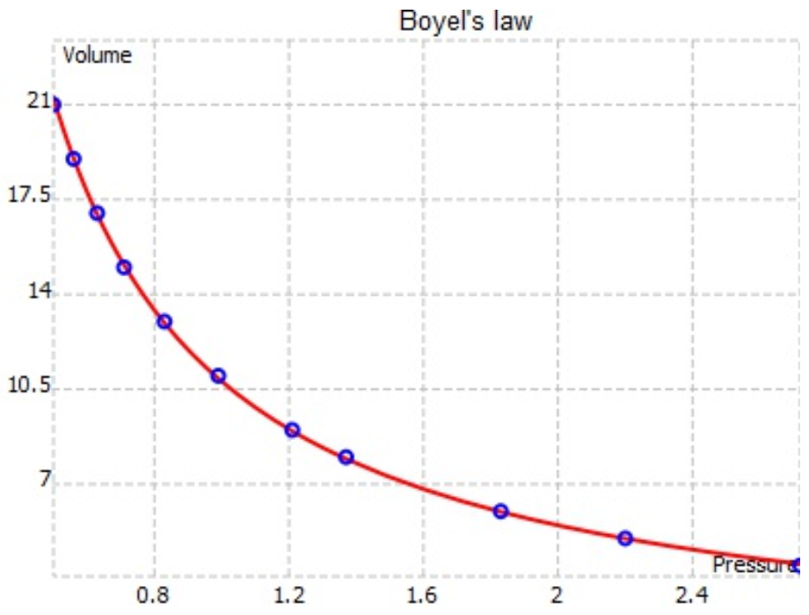
Curve Fitting
In engineering, two types of applications are encountered:
Trend analysis: extrapolating data model to predict future behaviour.
Hypothesis testing: comparing/testing measured data with existing mathematical model.

Slide 4
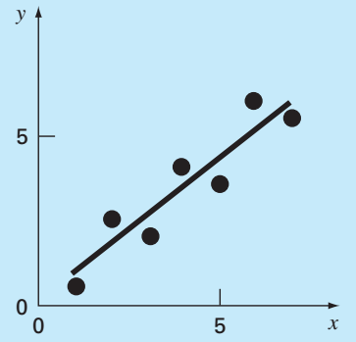
Linear Regression
A simplest approach to fitting a straight line to a set of data using least-square approximation.
Objective is to find coefficient/equation with minimum residual
For bets fit curve:
Using least-square:

Slide 5
Linear Regression
To determine coefficients:

Slide 6
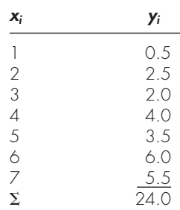
Linear Regression
Example: Fit a straight line for given data.
Best fit line:

Slide 7
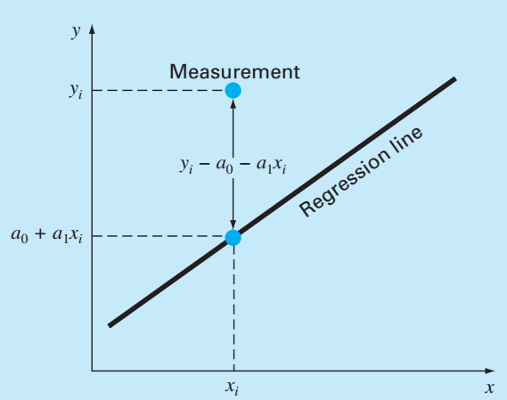
Error in Linear Regression
Standard Deviation of data
Standard Error
If
fit line is acceptable.
Correlation coefficient
If
fit line will have zero percent error (ideal case).
If
fit line need to improve.

Slide 8
Linear Regression
Step 1: Input of data set (x_{i} , y_{i}).
Step 2: Estimate straight line coefficients
Step 3: Estimate standard deviation of data set S_{y} , standard error of curve fit S_{y/x} :
(a) If S_{y/x} < S_{y} , the curve fit is acceptable.
Else, straight line fit is not compatible.
(b) Find correlation coefficient r to show confidence of curve.

Slide 9
MATLAB© Script
MATLAB Program for Linear Regression Method
clear all
clc
x = 1:7; % independent variable data set
y = [0.5 2.5 2.0 4.0 3.5 6.0 5.5]; % dependent variable data
n=length(x);
x_sum = sum(x);
y_sum = sum(y);
x_mean = mean(x);
y_mean = mean(y);
xy_sum = 0;
xi_sqsum = 0;
for i=1:n
xy_sum = xy_sum + x(i)*y(i);
xi_sqsum = xi_sqsum + (x(i))^2;
end
a1 = ((n*xy_sum) - x_sum*y_sum) / (n*xi_sqsum - x_sum^2)
a0 = y_mean - a1*x_mean
% Check with inbuit function
coef = polyfit(x,y,1)
% Plot data with curve
figure
hold on
plot(x,y,'d','LineWidth',1,'MarkerEdgeColor','k','MarkerFaceColor','g','MarkerSize',10)
yc = polyval([a1 a0],x);
plot(x,yc,'-b','LineWidth',2)
hleg=legend('Data set','Fitted Curve','Location','North');
set(hleg,'FontAngle','italic')
grid on; box on; axis on
hold off

Slide 10
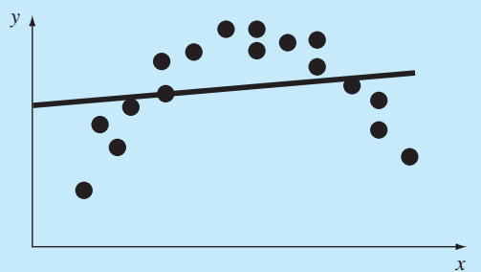
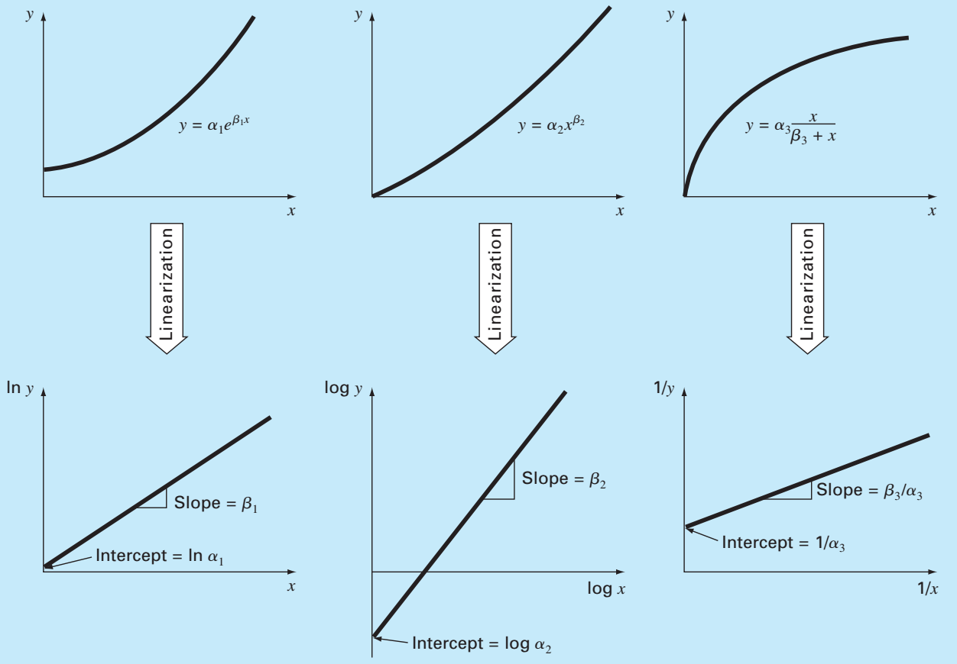
Linearization
For non-linear data set, linear regression can be applied after linearization of data set.

Slide 11
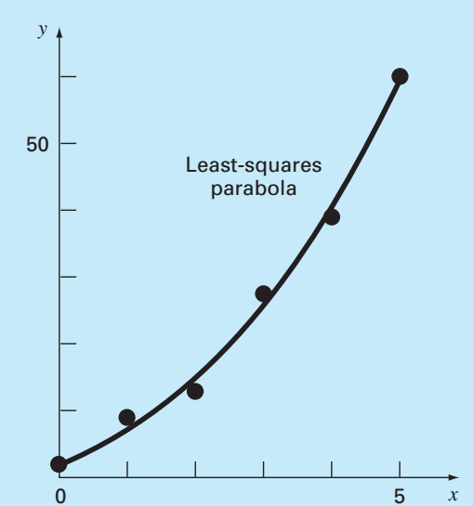
Polynomial Regression
A polynomial based curve is used to fit for a set of data using least-square approximation.
Objective is to find coefficient/equation with minimum residual
Using least-square:

Slide 12
Polynomial Regression
Objective is to find coefficient/equation with minimum residual
Standard Error
Determination coefficient

Slide 13
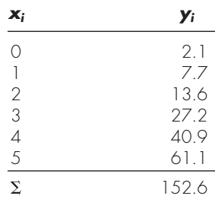
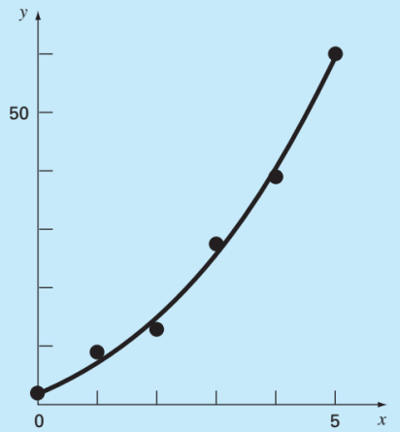
Polynomial Regression
Example: Fit a second order polynomial for given data.
Best fit line:
Determination coefficient

Slide 14
Polynomial Regression
Step 1: Input order of polynomial to be fit m.
Step 2: Input n data sets (x_{i} , y_{i}).
Step 3: If n < m+1, print data set is insufficient, otherwise continue
Step 4: Compute the elements of least square approximation equations in the form of augmented matrix.
Step 5: Solve the augmented matrix for coefficients a_{0,} a₁ , a₂ , a₃ , a₄ ,… a_{n} .

Slide 15
MATLAB© Script
MATLAB Program for Polynomial Regression (Quadratic)
clear all
clc
x = 0:5; % data set
y = [2.1 7.7 13.6 27.2 40.9 61.1]; % data set
n=length(x);
x_sum = sum(x);
y_sum = sum(y);
x_mean = mean(x);
y_mean = mean(y);
x2sum = 0;
x3sum = 0;
x4sum = 0;
xy_sum = 0;
x2y_sum = 0;
for i=1:n
x2sum = x2sum + (x(i))^2;
x3sum = x3sum + (x(i))^3;
x4sum = x4sum + (x(i))^4;
xy_sum = xy_sum + x(i)*y(i);
x2y_sum = x2y_sum + (x(i)^2)*y(i);
end
C=[n x_sum x2sum; x_sum x2sum x3sum;...
x2sum x3sum x4sum];
b= [y_sum; xy_sum; x2y_sum];
A = inv(C)*b;
a0 = A(1); a1 = A(2); a2 = A(3);
% Check with inbuilt function
coef = polyfit(x,y,2)

Slide 16
Nonlinear Regression
Determine the values of parameters of non-linear fitting, to minimize the sum of the squares of the residuals.
Gauss-Newton Method: A algorithm for minimizing the sum of the squares of the residuals between data and nonlinear equation.
Objective is to find coefficient/equation with minimum residual
Using Taylor series:

Slide 17
Nonlinear Regression
From Taylor series implementation:
Applying linear least square:
Limitations of Gauss-Newton Method:
Calculation of partial derivative of function.
Converge slowly.
Oscillate widely.
May not converge, some times.

Slide 18

Nonlinear Regression (Gauss-Newton Method)
Example: Fit given nonlinear function for given data.
Use initial guesses
Partial derivatives of function:
First Iteration:

Slide 19
Nonlinear Regression (Gauss-Newton Method)
Second Iteration as so on till acceptable tolerance!!!

Slide 20
MATLAB© Script
MATLAB Program for Gauss-Newton Regression (Nonlinear)
clear all
clc
X = 0.25:0.5:2.25; % data set
Y = [0.28 0.57 0.68 0.74 0.79]; % data set
A0 = 1; A1 = 1;% Initial guess
n=length(X);
syms a0 a1 x
fun=a0*(1-exp(-a1*x));
fun_diff0=diff(fun,a0);
fun_diff1=diff(fun,a1);
dfa0 = subs(fun_diff0,a1,A1);
dfa0 = vpa(dfa0);
dfa1 = subs(fun_diff1,a0,A0); % Initial guess a1=1
dfa1 = subs(dfa1,a1,A1);
dfa1 = vpa(dfa1);
function y =gaussnewfun(a0,a1,x)
y=a0*(1-exp(-a1*x));
for i = 1:n
dFa0 = subs(dfa0,x,X(i));
Z_a0(i) = double(dFa0);
dFa1 = subs(dfa1,x,X(i));
Z_a1(i) = double(dFa1);
D(i,1) = Y(i) - gaussnewfun(A0,A1,X(i));
end
z = [Z_a0' Z_a1' ];
Z = z'*z;
DA = (inv(Z))*(z'*D);
A = [A0; A1]+DA % First iteration coefficient

Slide 21


THANK YOU
Questions??

